Slide 1


Project members:-
Alok Kumar(21BCS8898)
Md. Faizan Anwar(20BCS3028)
Ebhuthi Venkata Sai Krishna(20BCS4375)
Manik Shangloo(21BCS8899)
Aditya ranjan(21BCS8110)

Slide 2


Slide 3
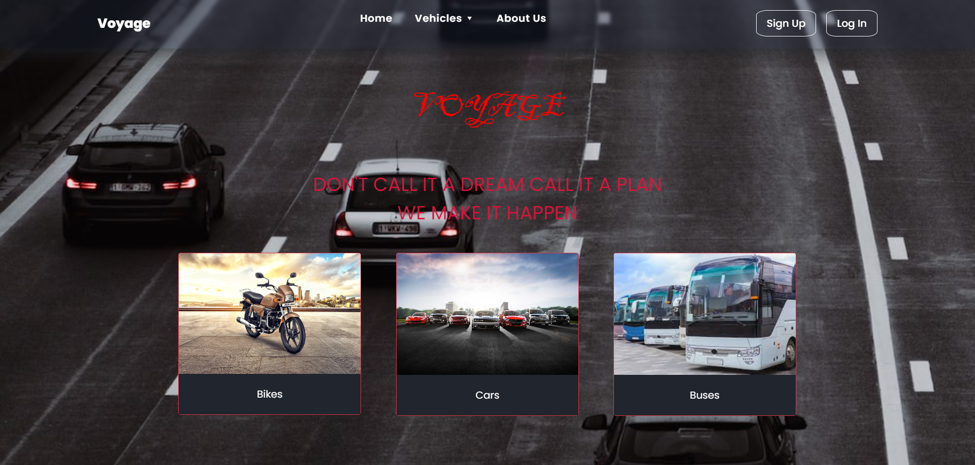
IMAGES OF WEBSITE
HOME PAGE

Slide 4
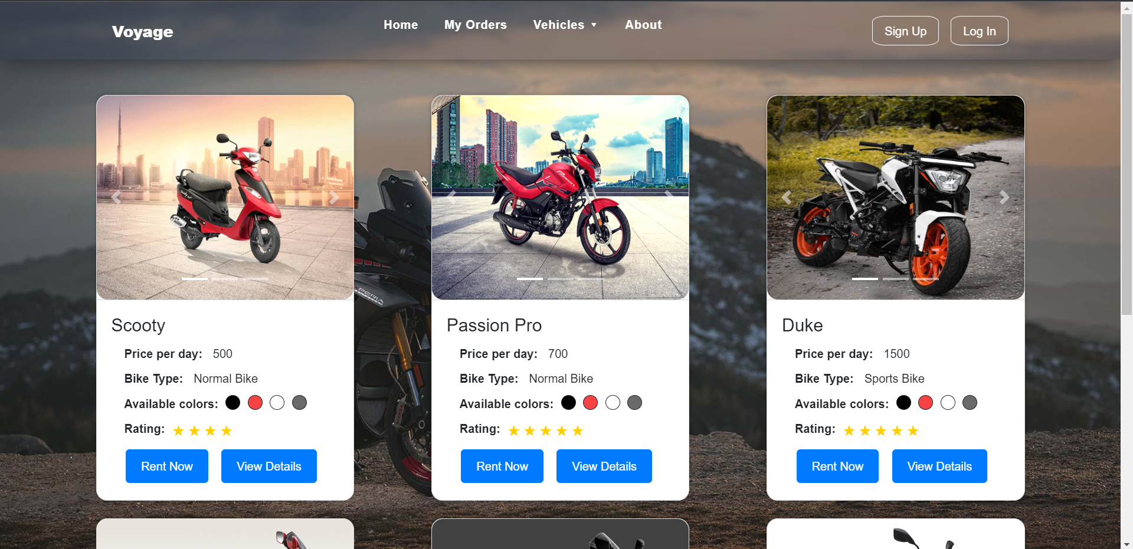
BIKE PAGE:-

Slide 5
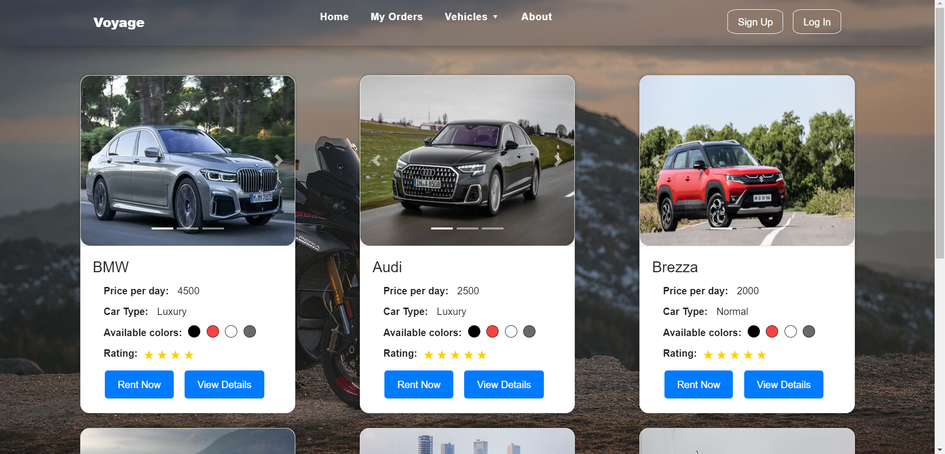
CAR PAGE:-

Slide 6
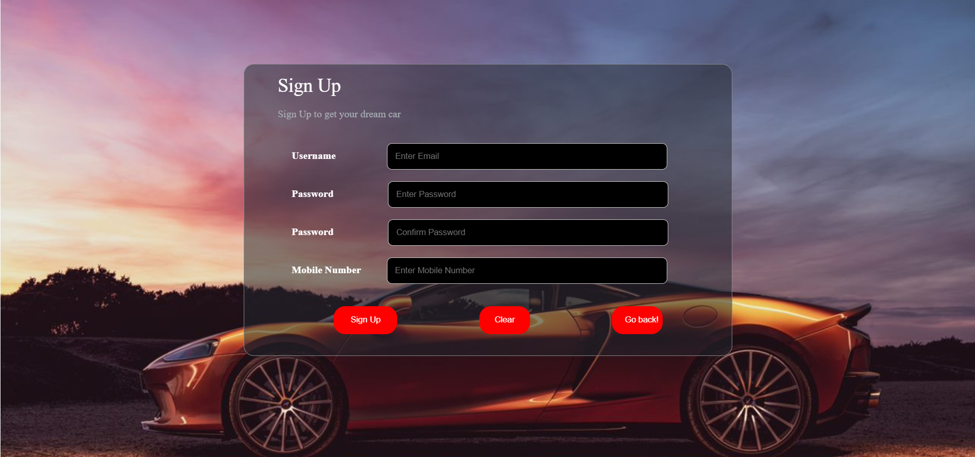
SIGN-UP PAGE:-

Slide 7
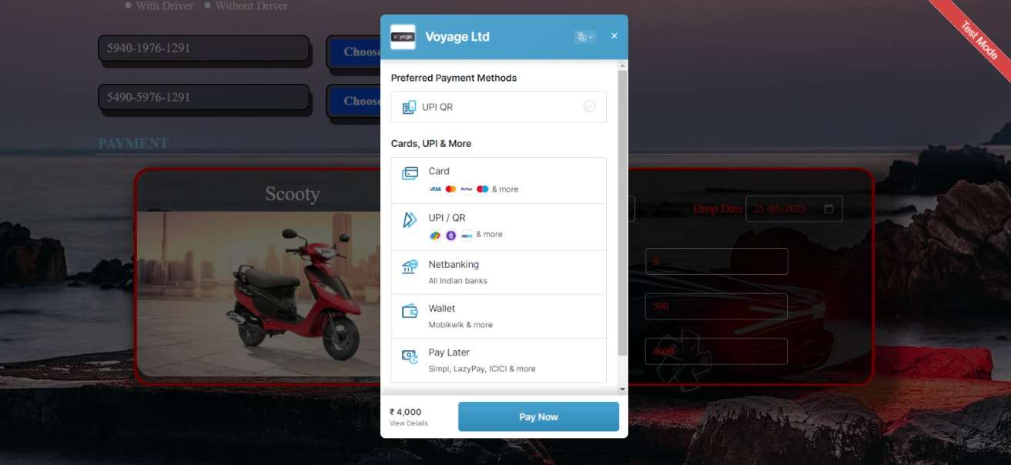
PAYMENT PAGE

Slide 8
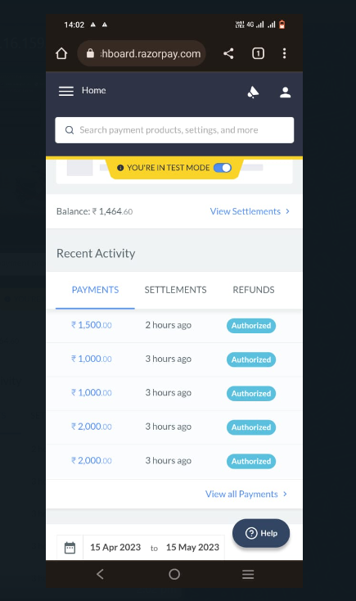
SUCCESSFUL PAYMENTS

Slide 9






TOOLS USED:-
HTML
CSS
JS
NODE.JS
EXPRESS
MONGODB

Slide 10


Slide 11


Slide 12


Slide 13


Slide 14


Slide 15


